Slide 1
Interaction Networks in Biology:
Interface between Physics and Biology
Shekhar C. Mande
Centre for DNA Fingerprinting and Diagnostics
Hyderabad

Slide 2
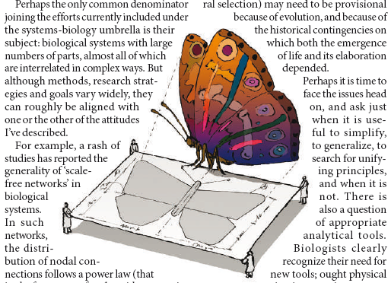
Emerging Paradigm of Modern Practice of Science
Integration of all branches of sciences (learning)…….
Does biology have laws that are universally applicable?
For Physical scientists, search for universal laws is a high priority
For Life Scientists, exceptions to the laws does not cause alarms. These are only reminders of how complex biological systems are!
Nature (2007) 445, 603

Slide 3
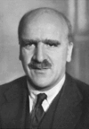
John Burdon Sanderson Haldane (1892-1964) was an English biologist who utilized mathematical analysis to study genetic phenomena and their relation to evolution.
Genetics is the first biological science which got in the position in which physics has been in for many years. One can justifiably speak about such a thing as theoretical mathematical genetics, and experimental genetics, just as in physics. There are some mathematical geniuses who work out what to an ordinary person seems a fantastic kind of theory. This fantastic kind of theory nevertheless leads to experimentally verifiable prediction, which an experimental physicist then has to test the validity of. Since the times of Wright, Haldane, and Fisher, evolutionary genetics has been in a similar position.
— Theodosius Dobzhansky
JBS Haldane

Slide 4
Hypothesis:
To understand a complex system, one must understand interactions among all the components of the system, and study the temporal dynamics of these interactions, and how these interactions change in response to internal/ external stimuli.

Slide 5
Properties of real world systems depend upon numerous interactions among the components within the systems…….
System | Component
Biosphere | Different societies, populations, organisms
Society/ colony | Individuals
Multicellular organism | Cells
A single cell | Molecules (DNA/ Proteins/ Lipids/…)

Slide 6
Experimental Methods to study
Protein-Protein Interactions
Yeast-two hybrid assay
Synexpression
Mass spectrometry of purified complexes
- Co-immunoprecipitation
- Pull down assays
In silico predictions
- Genome context methods
- Bayesian networks approach

Slide 7
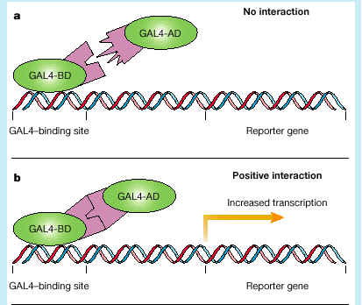
Yeast 2-hybrid

Slide 8
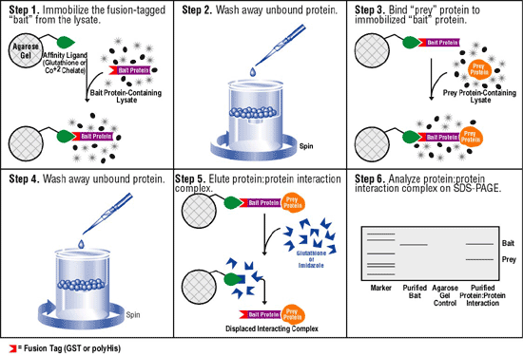
Affinity Pull-down assay followed by Mass Spectrometry

Slide 9
Prediction of protein-protein interactions
Conserved Gene neighborhood
Conservation of gene order
Protein phylogenic profiles
Domain fusion (Rosetta Stone)
Statistical co-evolution analysis

Slide 10
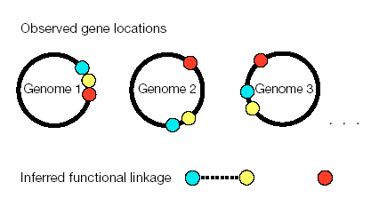
Conserved gene – neighborhood

Slide 11
Conservation of gene order
Co-directional transcription
Genome 1
A
B
D
E
Orthologue
A₁
B₁
D₁
E₁
Genome 2
Conditions
  Co-directional transcription (A,B and A1, B1)
  Intergenic distance should be smaller ( less than 300 bp ) (A,B and A1, B1)
  Genes should be orthologous (A,A₁ and B, B₁)
  Score = Number of orthologous gene pairs + sum of phylogenetic distances
Overbreek at al., in silico Biology, 1998

Slide 12
Phylogenetic profiles
Principle
  During evolution, functionally linked proteins tend be preserved or eliminated
Method
  phylogenetic profile is a string that encodes presence or absence of a protein in every known genome
  Proteins having similar or matching profiles strongly tend to be functionally linked
  Assign the function to uncharacterized proteins by examining the function of protein with similar profile.
Pellegrini et al., PNAS, 1999

Slide 13
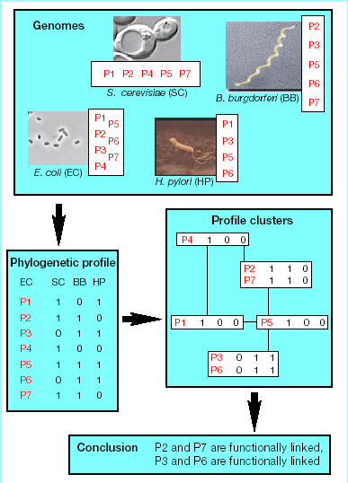
Phylogenetic profiles
Pellegrini et al., PNAS, 1999

Slide 14
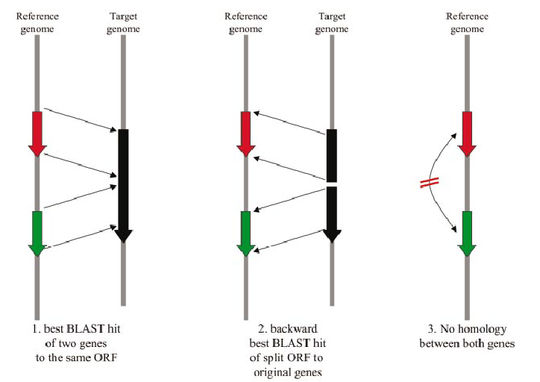
Domain fusion method
Marcotte et al., Science, 1998

Slide 15
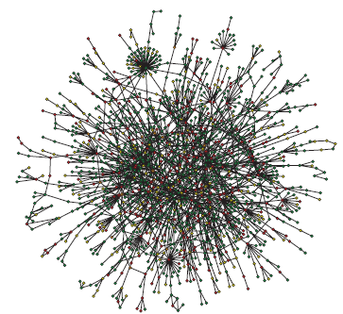
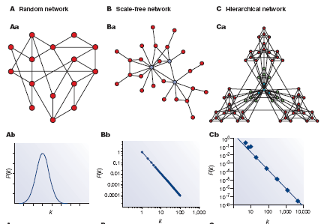
Properties of real world systems depend upon numerous interactions among the components within the systems…….
Adapted from Barbasi and Oltvai, Nature Rev. Genet., 2004

Slide 16
How does one analyse the networks?
Graph Theory

Slide 17
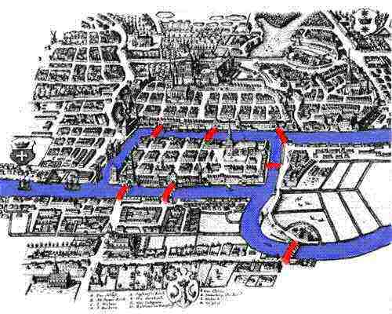
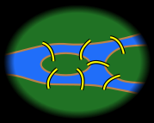
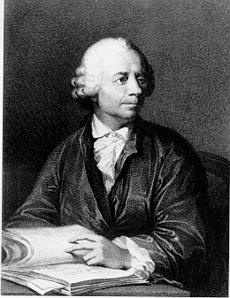
Seven bridges of Königsberg
Is it possible to walk a route that crosses each bridge exactly once?
Eliminate all features except land masses and bridges connecting them
Replace each land mass with a dot (node) and each bridge with a line (edge)

Slide 18
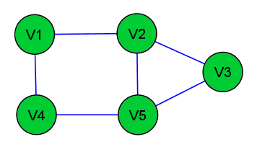
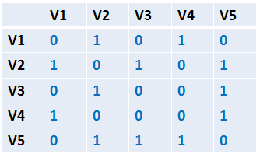
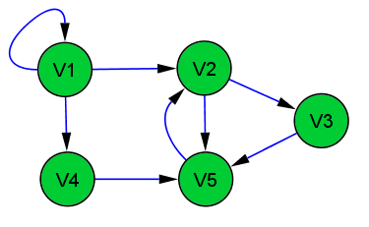
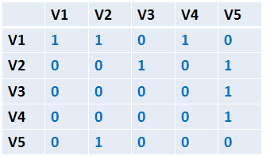
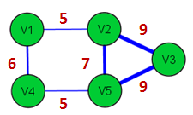
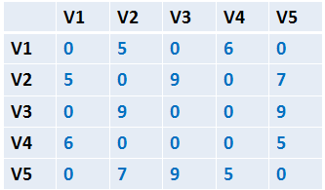

Slide 19
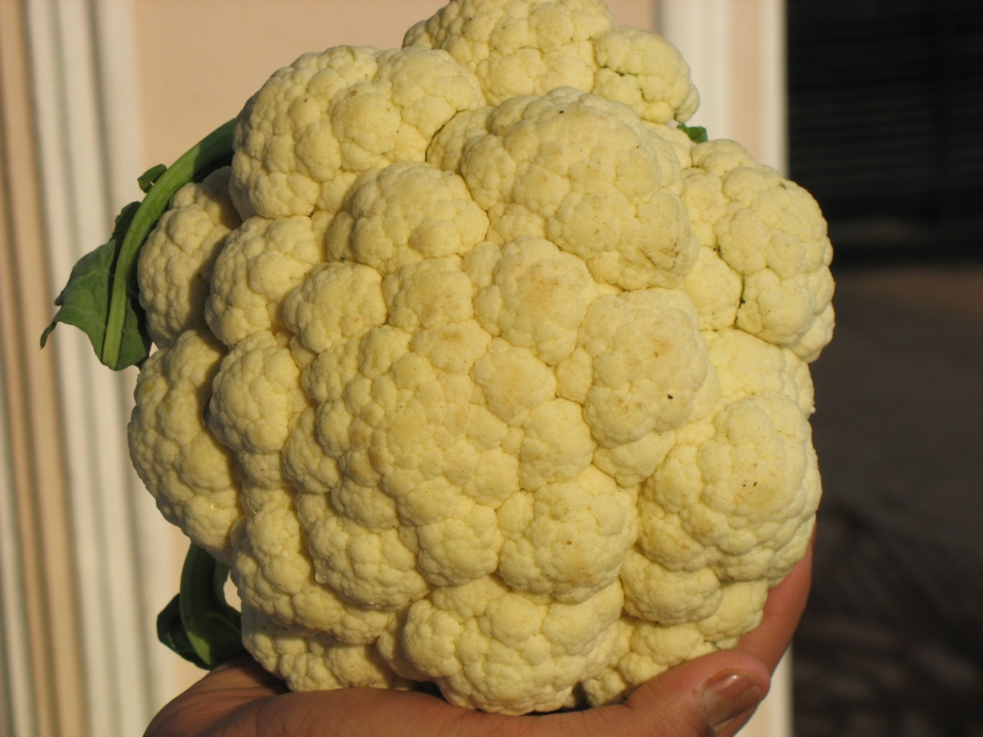

Self Similarity

Slide 20
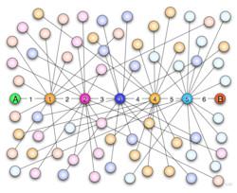
Six Degrees of Separation

Slide 21
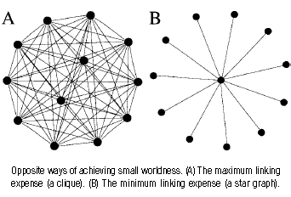
Some topological properties

Slide 22
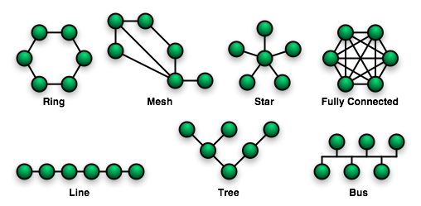
Common Topologies

Slide 23
Robustness against random node failure

Slide 24
Robustness against random node failure

Slide 25
Robustness against random node failure

Slide 26
Robustness against random node failure

Slide 27
Robustness against random node failure

Slide 28
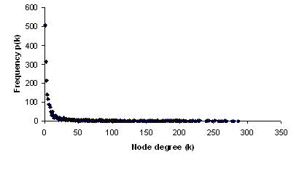
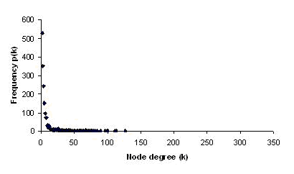
Correlation of the interactome with gene essentiality data
Essential
genes
Non-essential
genes
Yellaboina, Goyal and Mande, Genome Res, 2007

Slide 29




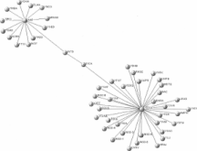
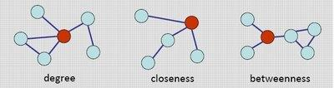
Centrality-Lethality correlations in Graph Theory
Degree centrality | A node with a high degree
Closeness centrality | A node which can connect to any other node with shortest path length
Information centrality | A node which plays an important role in maintaining robustness of the graph, i.e. its removal leads to increase in average path length
Betweenness centrality | A node through which maximum shortest paths traverse

Slide 30
Challenges ahead….
How does one obtain reliable networks?
  Experimental/ computational
  Predictions such as host-pathogen interactions
Can we make reliable predictions of gene essentiality, conditional essentiality and synthetic lethality?
  Which genes are critical under what experimental conditions?
  Predictions of biochemical functions of proteins
How does the study of network dynamics lead to observable phenotypes?
  Response to stimuli
  Differentiation and development
  Biological shape
Are there universal laws that govern biological interactions?

Slide 32
